Slide 1
Relocation Analysis Tool
Your personalized city to city comparison

Slide 2
Business justification
As a relocation service company:
Customers’ main problematic: lack of visibility on their destination city
Expectation:
Compare to what they know
Be provided with several alternatives
Solution explored:
Provide a generic city to city comparison tool working worldwide
Establish comparison with a given reference neighbourhood profile
Determine similar neighbourhood in destination city
Determine different alternative flavors

Slide 3
Scenario: Let’s explore the possibilities through an example
Customer moving from east of Singapore ( Paya Lebar area) to Toronto
Looking for a neighborhood close to central district where his company is based
Looking for a similar neighbourhood feeling
Interesting to get alternative suggestions, mostly according to Arts & Entertainment venues

Slide 4
Data acquisition and cleaning
Current address of customer
Converted in geocoordinates using Nomination API
Future search area
Defined by its center and radius of search
Venues information gathered from Foursquare API
Categories API to map sub-categories with master categories (Food, Art etc.)
Explore to get most recommended venues in the different neighbourhoods to establish their profile

Slide 5
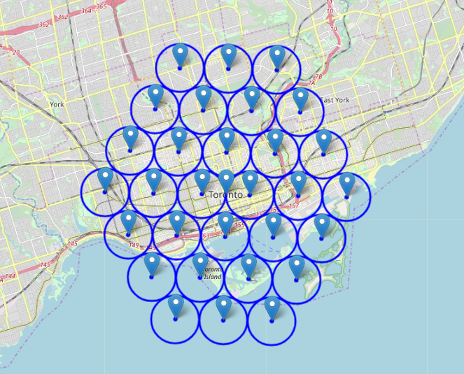
Data preparation
A grid of 30 Neighbourhood built on destination area to explore

Slide 6
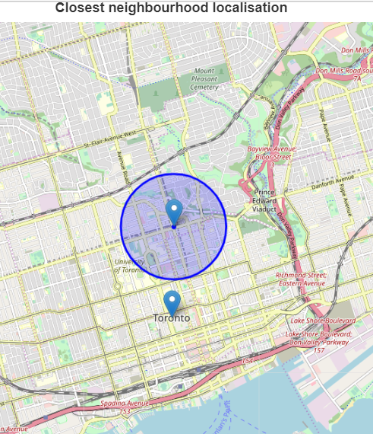
Closest neighbourhood identified and located
Based on future neighbourhood profiles, compared to reference
Using least square calculation
Neighbourhood close to Bloor-Yonge is identified as the closest to what reference neighbourhood in Singapore is

Slide 7
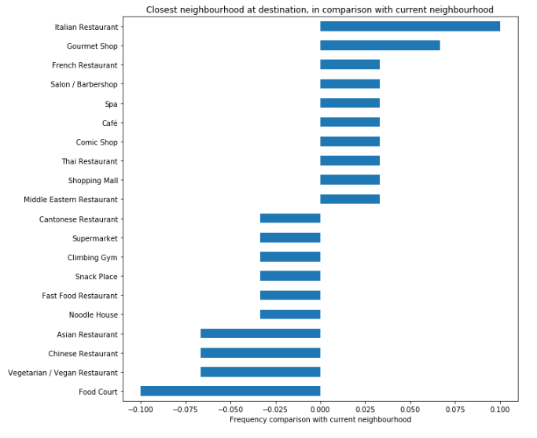
Closest neighbourhood identified and located
Main highlights when comparing both neighbourhoods seems to be on the food places: Food courts and Asian restaurants are replaced by Italian Restaurant and Gourmet Shops.
Most other venue categories frequencies are quite similar

Slide 8
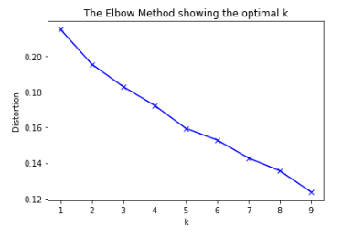
Clusterisation based on Art & Entertainment
Clusterisation methodology tentatively based on Elbow method.
This eventually did not highlight an optimum, selection was therefore manual

Slide 9
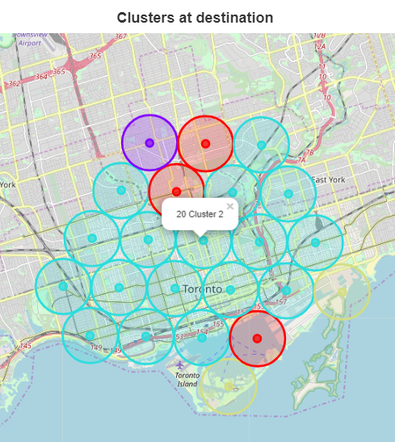
Clusterisation based on Art & Entertainment
This area of Toronto appeared to be quite homogeneous in terms of Arts & Entertainment venues
Cluster 20, identified previously as the more similar to reference however appears to be at walking distance to ‘Red’ cluster (cluster 0)

Slide 10
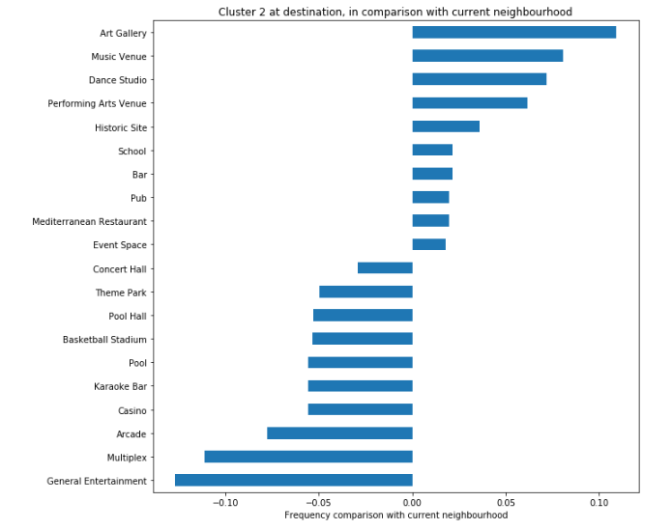
Clusterisation based on Art & Entertainment
Cluster 2 = ‘Art gallery and performances’ cluster.
Seems to lack some entertainment places

Slide 11
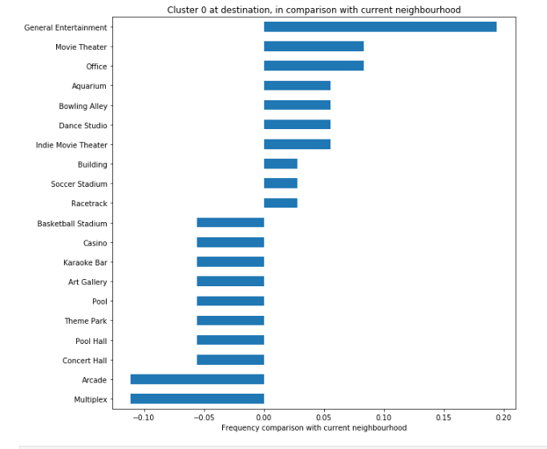
Clusterisation based on Art & Entertainment
Cluster 0 = ‘Entertainment cluster’, with general places, movie theaters, bowling etc.

Slide 12
Result of scenario
Cluster 20 provides an overall similar flavor than reference neighbourhood
On top, it presents more art related venues than reference, at walking distance to an entertainment oriented area
Recommendation is Cluster 20

Slide 13
Conclusion
Built an easy to use and adapt tool to perform comparative analyses of different neighbourhoods in an area; compared to a known reference
Allows to determine recommendations based on both:
Similitude (closest neighbourhood)
General flavors (clusterisation)
Working from any neighbourhood to any city
Allows to focus on particular categories of venues to provide more insights according to customer preference

